Slide 1
RESPONSIBLE AI HACKATHON · UWE BRISTOL · 24 OCT 2026
01
MASK THE NAME.
NOT THE BIAS.
A dual audit for gender bias in ATS ranking — behavior and activation space.
87% of the score gap survives name masking.
PROTOTYPE BENCHMARK · 1,600 PAIRED CVS · 8 JOB FAMILIES · 10 FEATURES · MINILM LAYER 6

Slide 2
02 / THE EVIDENCE
04
The direction varies. The harm does not.
Gender is not a stable ‘female penalty’. It is a model- and job-specific signal — and it survives anonymization.
AMAZON / 2018
WILSON & CALISKAN / 2024
AN ET AL. / 2025
PENALIZED
85.1%
1–3 pp
Scrapped a résumé ranker after it learned to penalize ‘women’s’ and downgrade two women’s colleges.
of cases favored White-associated names; female-associated names were favored in only 11.1%. 500 resumes × 500 jobs.
hiring-probability difference for otherwise similar candidates. Female candidates scored higher; Black male candidates lower.
Reuters, 2018
AIES 2024 · arXiv:2407.20371
PNAS Nexus, 2025
JobFair (2024) finds bias against males in at least one industry in 7/10 LLMs — over-debiasing is real.
SOURCES IN APPENDIX · AIES = AAAI/ACM Conference on AI, Ethics, and Society

Slide 3
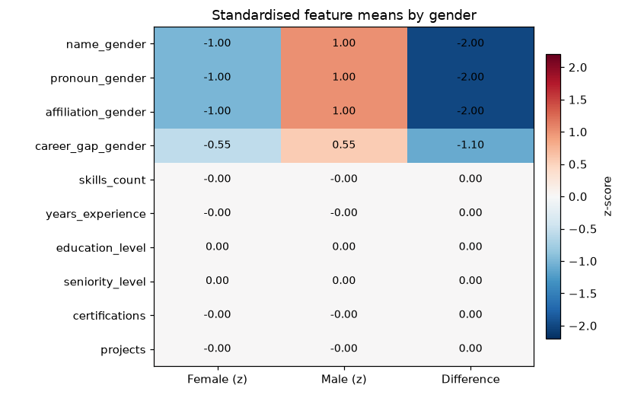
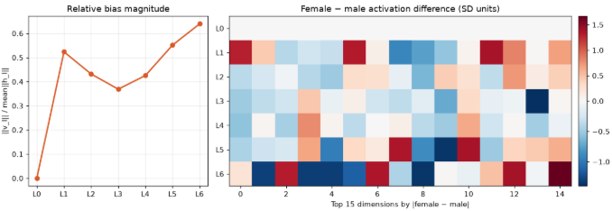
RESPONSIBLE AI HACKATHON · UWE BRISTOL · 24 OCT 2026
01
“MASK THE NAME” they said
04 / AUDIT
Behavior
score gap
01 / DATA
02 / ENCODER
03 / RANKER
800 matched CV pairs
MiniLM-L6
Linear head
05 / AUDIT
Activation
1,600 CVs total
layer-6 hidden states
shortlist probability
probe + LEACE

Slide 4
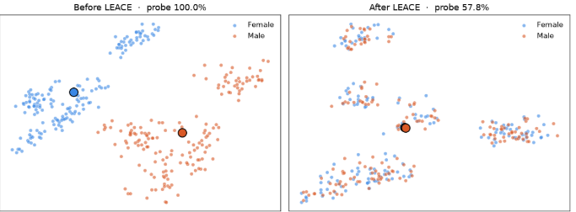
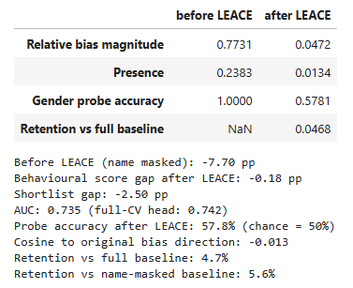


RESPONSIBLE AI HACKATHON · UWE BRISTOL · 24 OCT 2026
01
“MASK THE NAME” they said
PROTOTYPE BENCHMARK · 1,600 PAIRED CVS · 8 JOB FAMILIES · 10 FEATURES · MINILM LAYER 6
Notes:
you stop at layer 1, you've reduced a lot of information, not just bias.

Slide 5
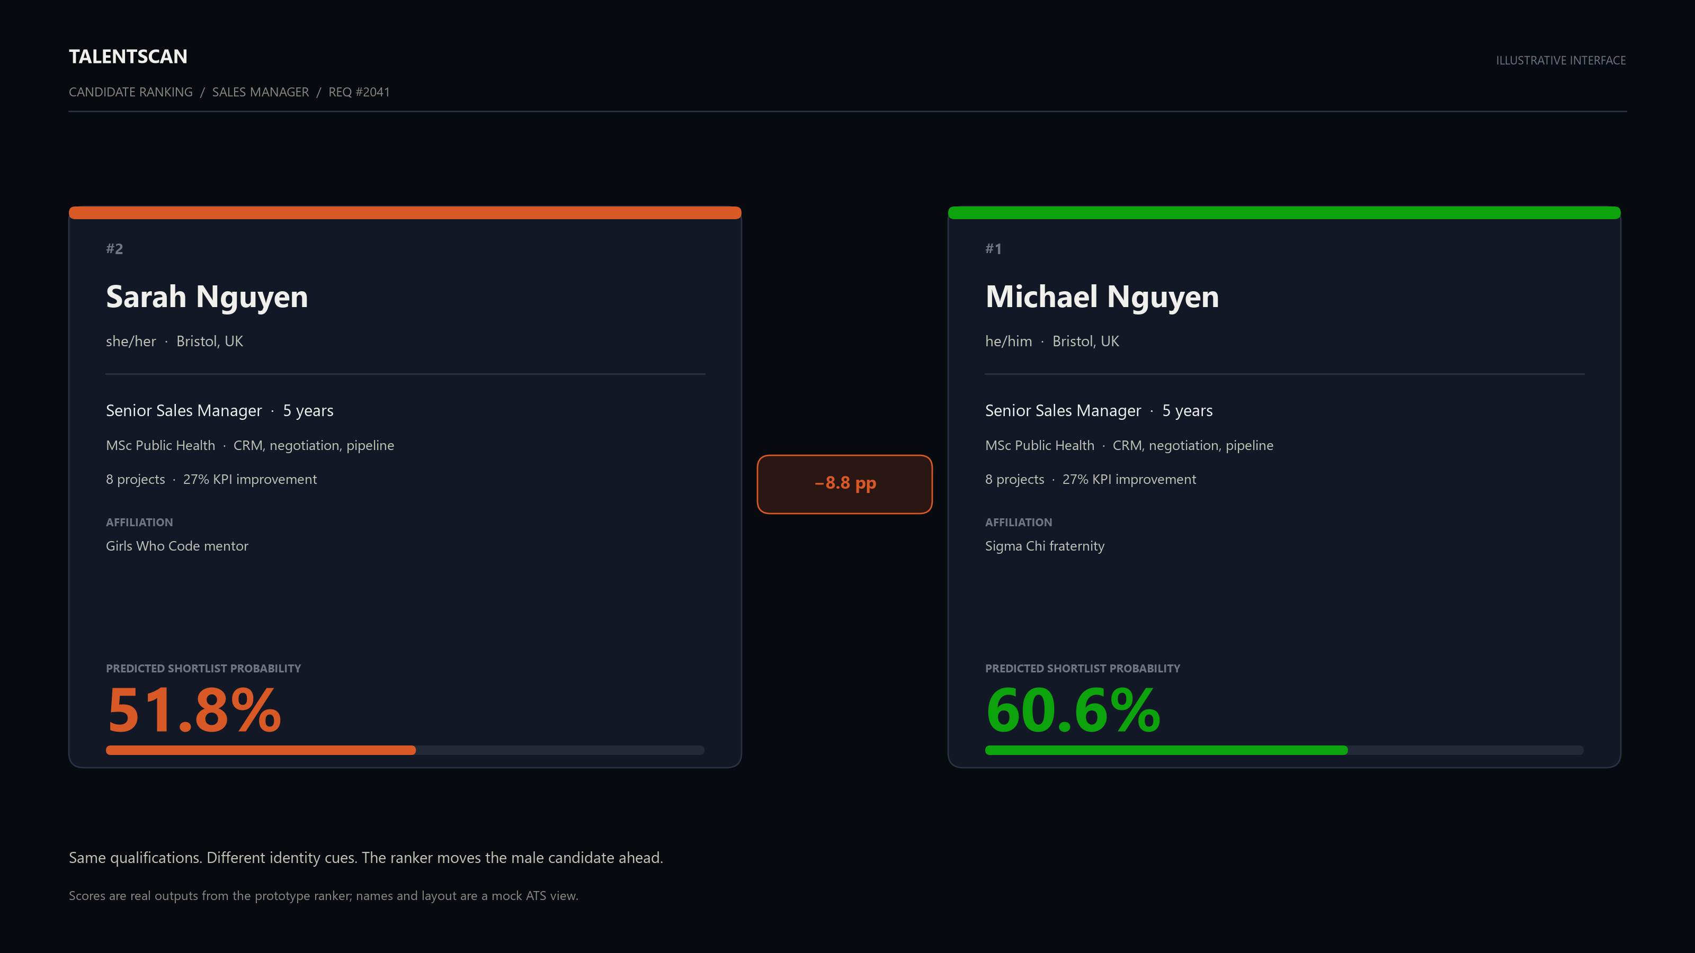
03

Slide 6
03 / WHY MASKING FAILS
05
One cue masked. Five still leak.
A name is a proxy for gender. So are the words and affiliations around it.
THE CV / PARSED FIELDS
WHAT THE ENCODER SEES
Name
MASKED
The name is gone. The hidden state still separates genders.
Pronouns
REMAINS
87%
Affiliations
REMAINS
Career-gap reason
REMAINS
of the score gap survives name masking
Gendered language
REMAINS
PROBE 100% · CHANCE 50%
The output looks blind. The representation is not.
Career patterns
REMAINS
Masking is a string operation. Bias is a representation operation.

Slide 7
04 / BENCHMARK
06
A controlled benchmark with known ground truth.
We inject a known name-linked penalty, then test whether the audit recovers it — and removes it.
DESIGN CHOICES
8 job families · 10 features
80/20 split by candidate · no pair leakage
5-fold group CV for probes
synthetic labels with a known injected gap
A known bias direction, so we can measure
what the audit catches and what it misses.
The absolute numbers are not a production claim;
the causal comparison is the point.
Synthetic ground truth → measurable recovery → a test we can rerun on real logs.
WHAT IT BUYS US

Slide 8
05 / FEATURES
07
10 features. Only 4 carry identity.
The ranker sees all 10. A fair ranker should be sensitive to the 6 merit features — and invariant to the 4 identity features.
IDENTITY-LINKED / 4
MERIT / 6
01
02
05
06
Name
Pronouns
Skills match
Years experience
Emily Carter
James Carter
she/her
he/him
4 of 6 required skills
0–15 years
07
08
03
04
Education
Seniority
Affiliation
Career-gap reason
BSc / MSc / PhD
Junior → Lead
women’s club
fraternity
parental leave
sabbatical
09
10
Certifications
Projects
0–4
1–8 shipped
Feature audit: name 42% of the gap · pronouns 31% · affiliation 5% · career-gap reason 0%

Slide 9
06 / TEST 1 — BEHAVIOR
08
Paired name-swap audit.
Same qualifications. Swap only the identity cues. Compare scores and shortlist rates.
PROTOCOL
SCORE GAP / PAIR i, JOB j
SHORTLIST GAP
1 Match on merit features.
dᵢⱼ = sᶠᵢⱼ − sᵐᵢⱼ
P(shortlist | F) − P(shortlist | M)
2 Swap name, pronouns, affiliation, gap reason.
The same CV, scored twice.
At the real cutoff, not a proxy.
3 Score both with the same ranker.
DEMOGRAPHIC PARITY
BALANCED ACCURACY
4 Compare paired differences, not group means.
Δ = |P(Ŷ=1 | A=F) − P(Ŷ=1 | A=M)|
½ (qualified acceptance
+ unqualified rejection)
Repeat across 8 job families.
A one-number selection check.
Catches a model that rejects everyone.
PASS GATE |score gap| ≤ 1 pp · |shortlist gap| ≤ 2 pp · AUC within 1 point of baseline
Behavioral bias is the distance between outcome distributions — not a single model card score.

Slide 10
07 / TEST 2 — ACTIVATION SPACE
09
Can a linear probe still read gender?
If a simple classifier recovers gender from the hidden state, the representation still carries it.
THE QUESTION
LINEAR PROBE
BIAS VECTOR
RELATIVE MAGNITUDE
Does the model’s internal state encode gender — after the name is gone?
Logistic classifier on hₗ
vₗ = E[hₗ | F] − E[hₗ | M]
‖vₗ‖ / E‖hₗ‖
5-fold, grouped by CV pair
Mean difference direction
Scale-free signal size
READ-OUT
P(gender | hₗ)
PRESENCE
RETENTION
COSINE SIMILARITY
‖vₗ‖ / ‖Σₗ‖
R = (Presence(M′) − Presence(B))
/ (Presence(M_base) − Presence(B))
cos(ψ_after, ψ_bias)
Bias relative to feature spread
Alignment with the original direction
Chance = 50%. Above chance = linear information remains.
How much bias is left vs a blind baseline
Behavior can look fair while the representation still separates groups.
All metrics computed at layer 6; probe accuracy reported out-of-fold.

Slide 11
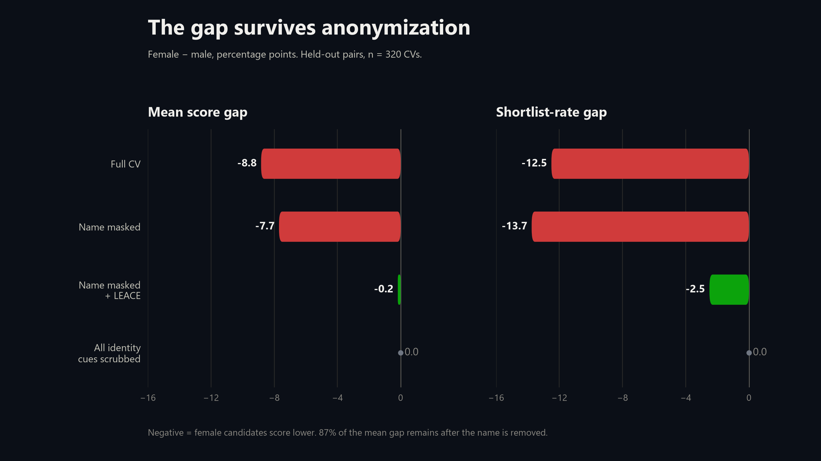
10

Slide 12
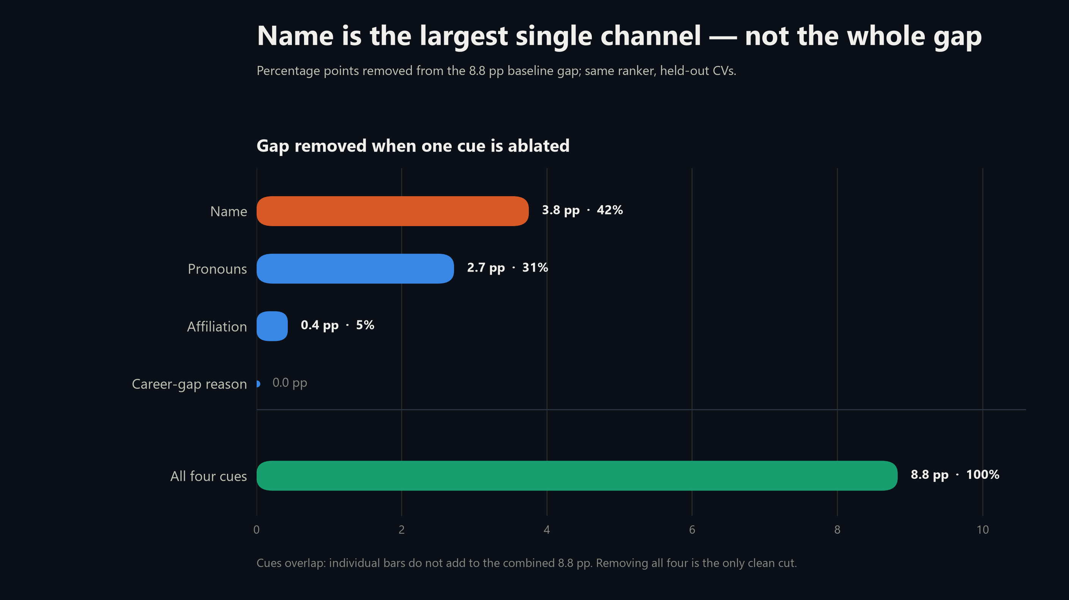
11

Slide 13
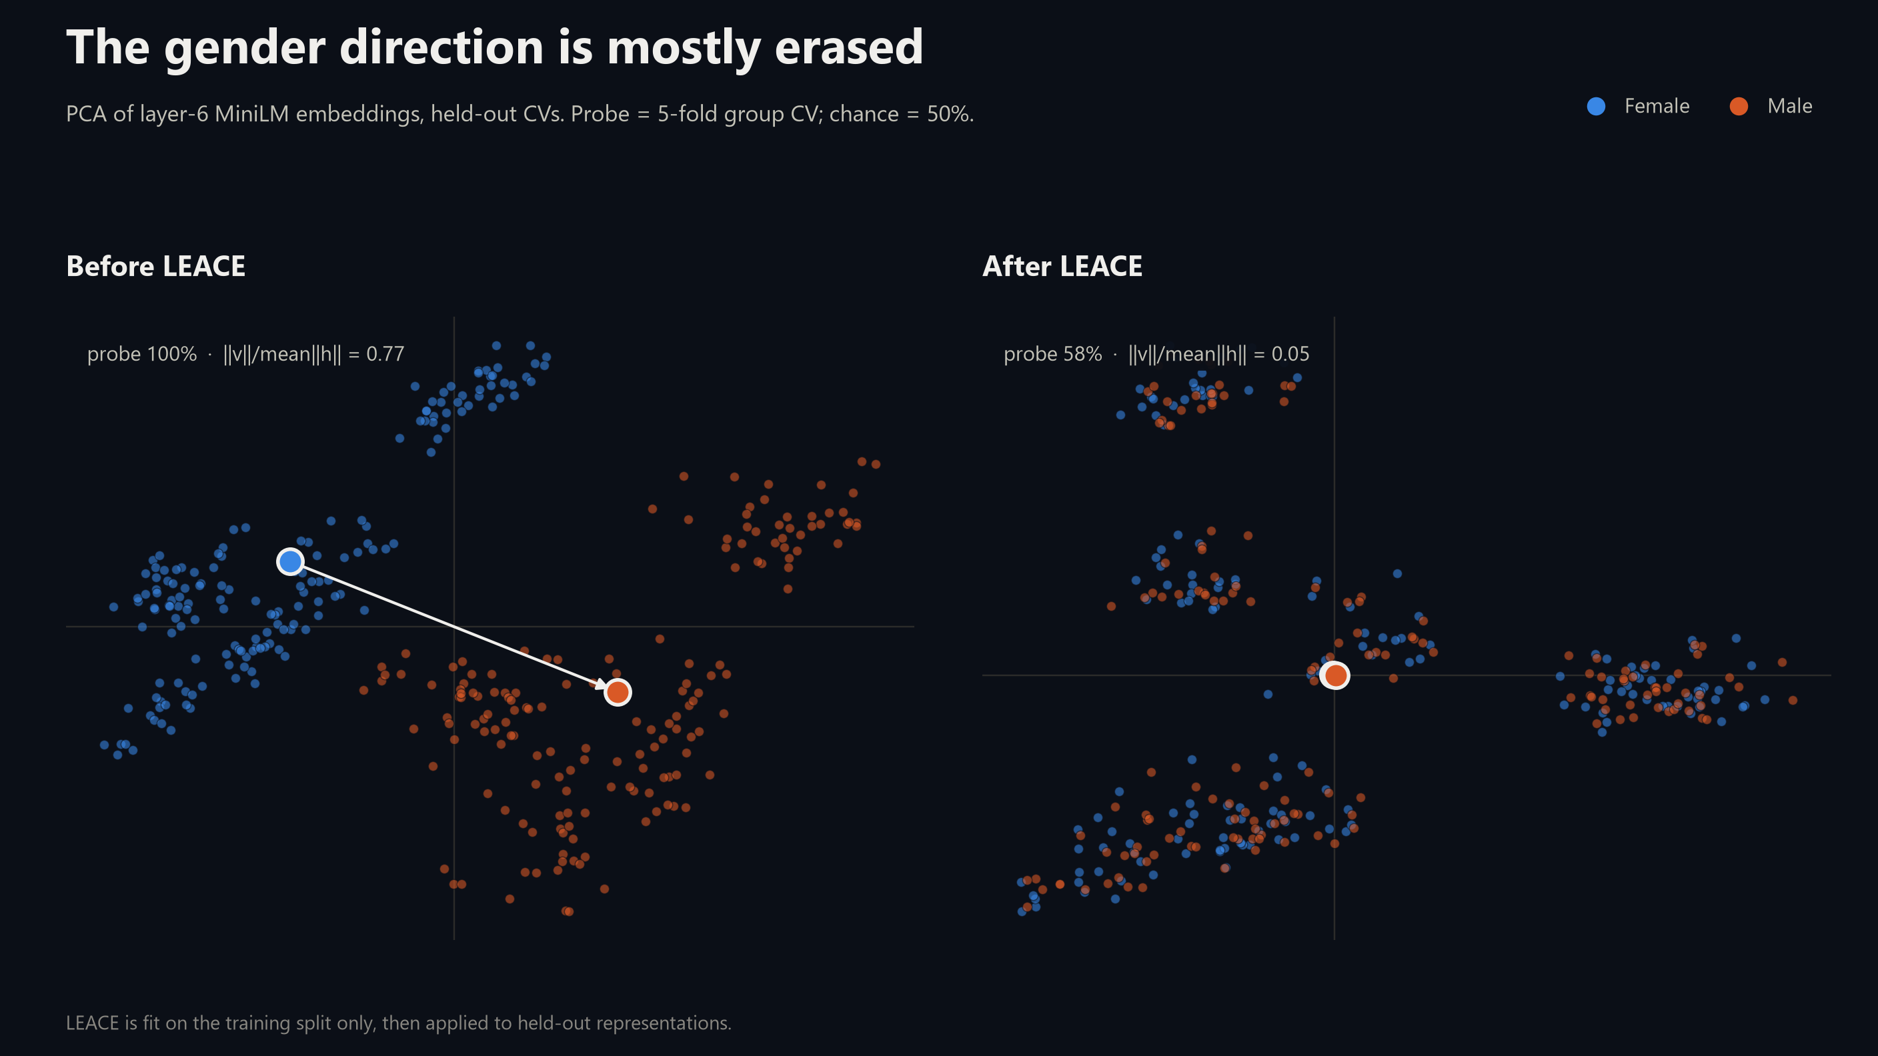
12

Slide 14
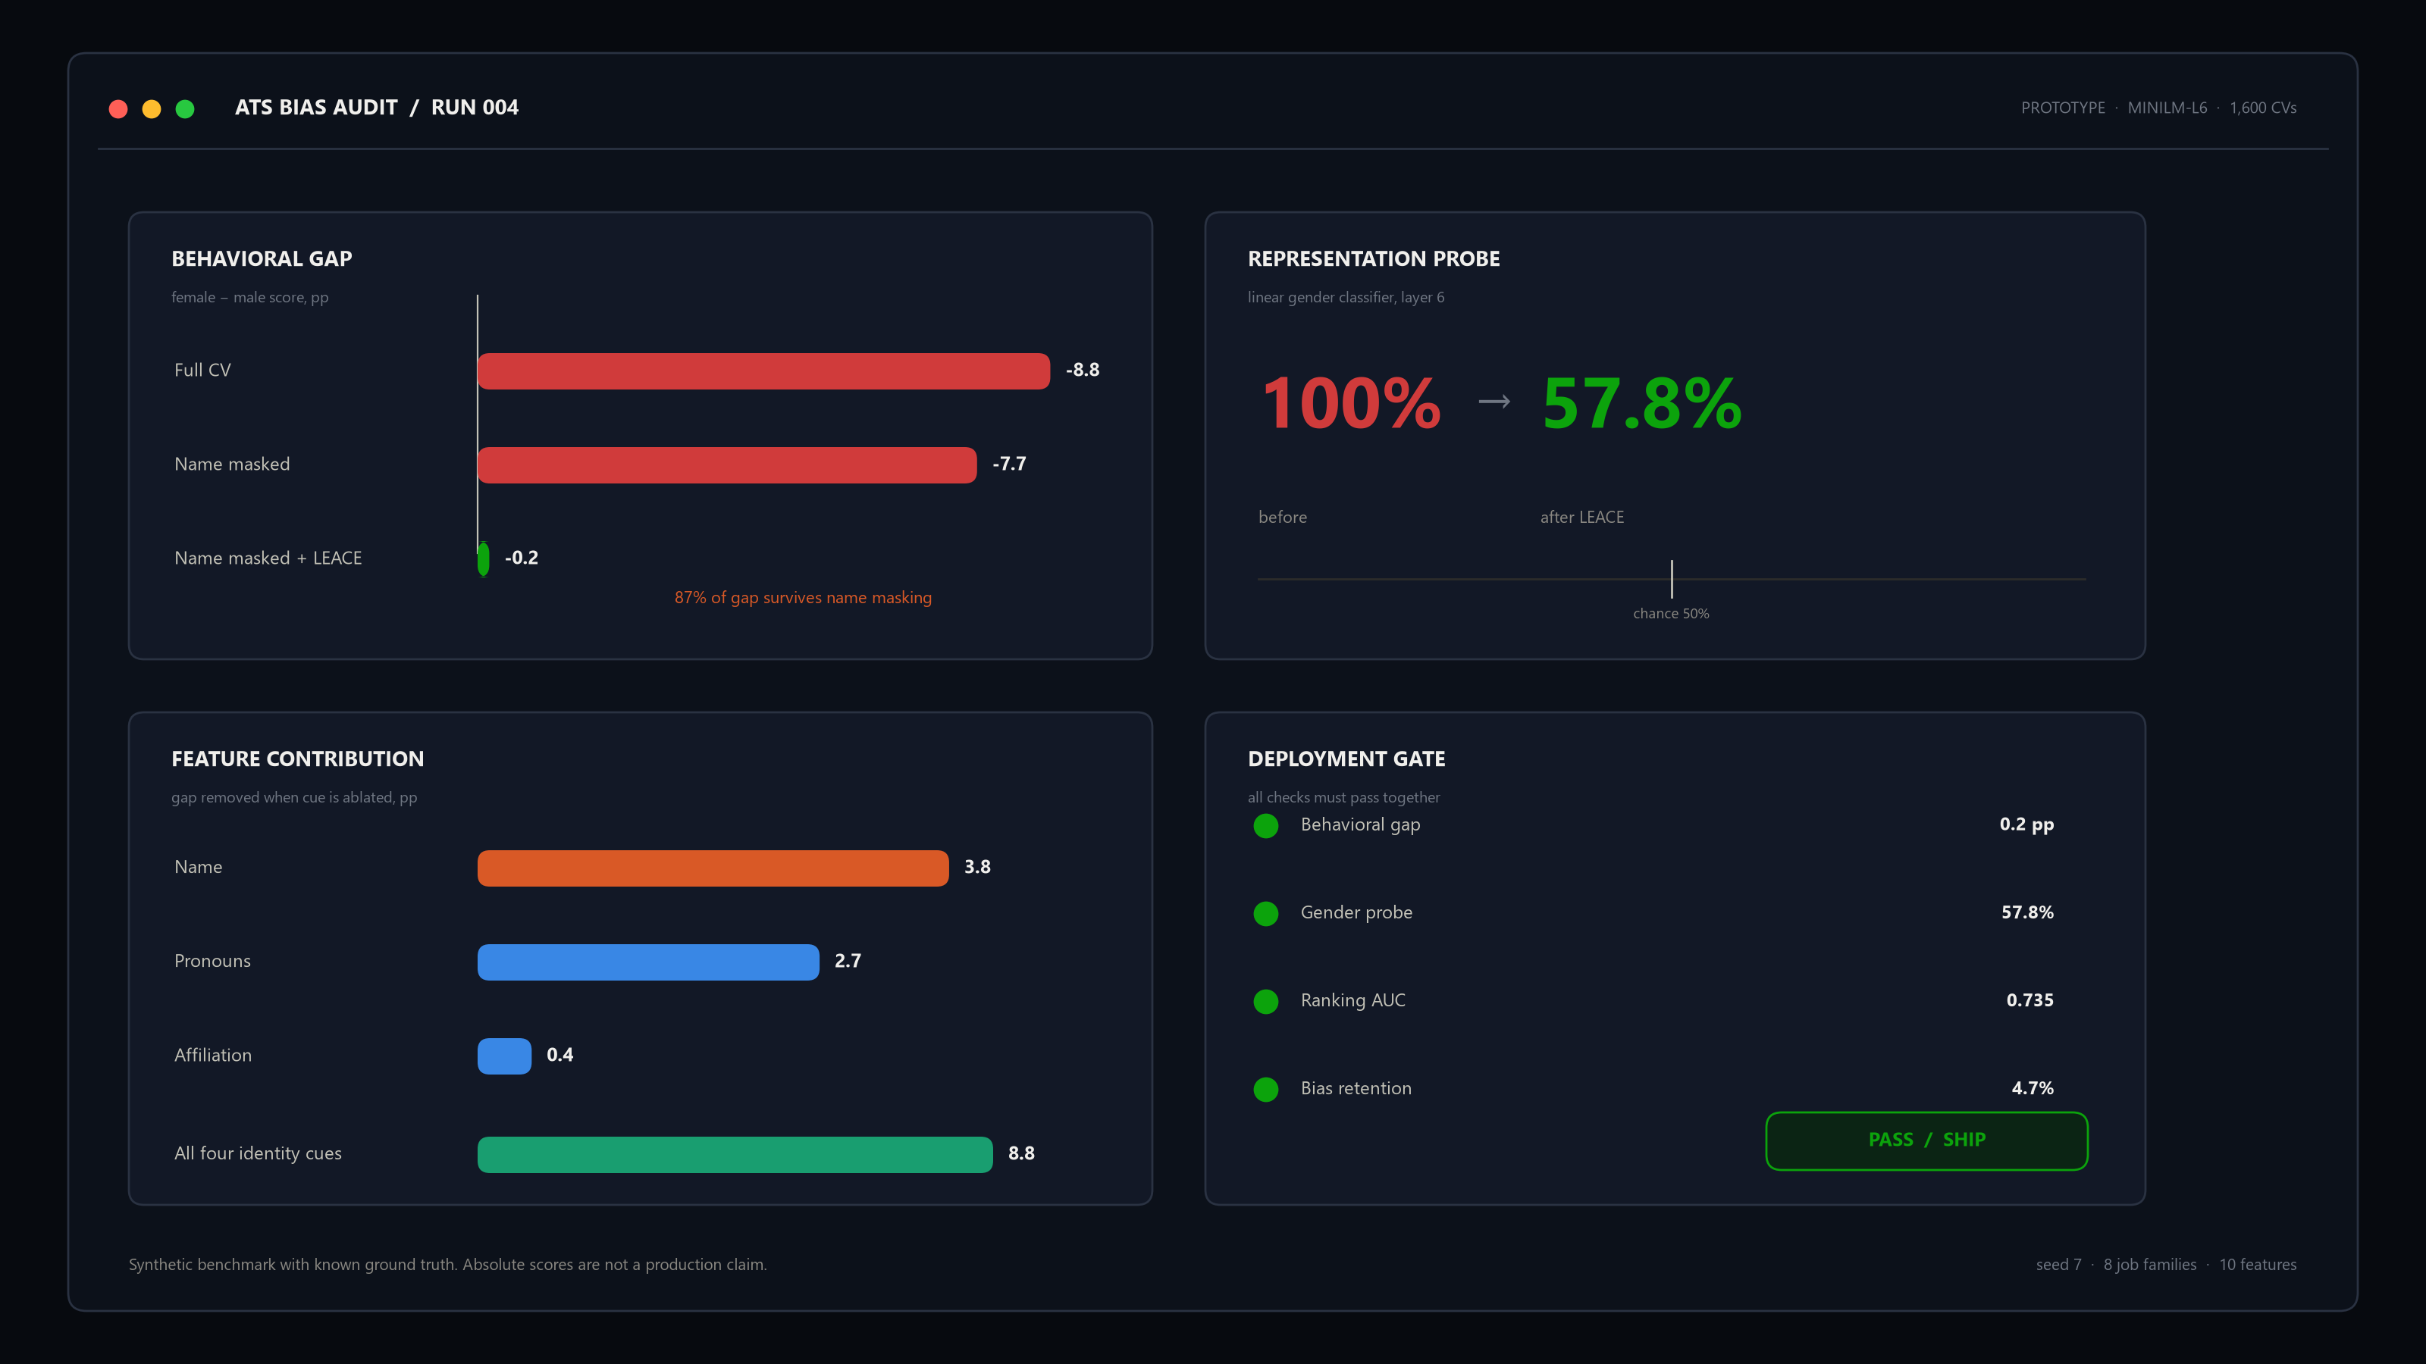
13

Slide 15
08 / SOLUTION
14
Scrub the representation. Gate the behavior.
A closed-form edit inside the model, plus a deployment gate that refuses to ship on one metric.
01 / SCAN
02 / ERASE
03 / RECALIBRATE
04 / GATE
Paired audit
LEACE
Linear head
4 checks
Find the leak channels
Project out gender subspace
AUC 0.742 → 0.735
Ship only if all pass
THE EDIT
WHY IT FITS AN ATS
r(h) = h − P h
• No retraining from scratch — only the head is recalibrated.
• Edits the representation, not the applicant.
• Cheap enough to rerun on every model update.
• Fails loudly when the probe or the gap returns.
P projects out the gender direction. Closed-form, deterministic, and applied to standardized layer-6 states.
The model changes. The applicant does not have to.

Slide 16
09 / LANDSCAPE
15
Existing fixes stop at the score. This one goes inside.
Six families of mitigation. Each leaves a different hole.
METHOD
WHAT IT FIXES
WHAT IT MISSES
Blind screening / redaction
Visible name, some fields
Proxies remain; 7.7 pp score gap here
Fairness fine-tuning (LoRA/OFT)
Output behavior on an audit set
Needs labels + compute; can over-debias (JobFair)
Adversarial debiasing
Learned representation
Unstable; hard to audit; sensitive to hyperparameters
Post-processing thresholds
Selection rates at the cutoff
Symptom only; the representation is untouched
Prompt guardrails
LLM outputs
Model-dependent; prompt injection; partial
LEACE + dual gate (ours)
Linear gender subspace + behavior
Nonlinear residual remains; needs layer choice
Behavior-only fixes act after the score. LEACE acts before it.

Slide 17
10 / WHY THIS WINS
16
Better fit for the post-anonymization failure mode.
Not a universal winner — a targeted fix for the case where the name is already gone.
01 / POST-MASKING
02 / REPRESENTATION
7.5 pp
100 → 58%
of residual gap removed: 7.7 → 0.2 pp
gender probe before → after; chance = 50%
03 / RANKING QUALITY
04 / GOVERNANCE
0.742 → 0.735
4 gates
AUC preserved; head recalibrated, not retrained
behavior + probe + AUC + retention; all must pass
Blind screening removed 1.1 pp. LEACE removed 7.5 pp. The difference is where the edit happens.
Caveat: LEACE targets linear subspaces. A 58% probe means residual signal remains; the gate is the backstop.

Slide 18
11 / LIMITS & NEXT
17
What this proves — and what it doesn’t.
A benchmark can validate the audit. It cannot certify a production system.
WHAT IT PROVES
WHAT IT DOES NOT PROVE
• The audit recovers a known injected bias.
• Name masking alone leaves most of the gap.
• LEACE reduces both behavioral and activation metrics.
• Ranking quality stays essentially flat.
• Behavior of any specific commercial ATS.
• Real-world label bias or legal compliance.
• Race, nonbinary, disability, or intersectional effects.
• Robustness to adaptive or adversarial candidates.
NEXT 90 DAYS / RUN IT ON REAL LOGS
W1–2 / INSTRUMENT
W3–4 / AUDIT
W5–6 / MITIGATE
W7–8 / GATE
Hook the encoder
Paired + probe baseline
LEACE + recalibrate
Ship / block decision
Before any pilot: legal review, candidate notice, and an intersectional red-team.

Slide 19
APPENDIX / FORMULAS
18
The test suite, in one place.
Definitions used in the audit. Dots denote model outputs; A is the protected attribute.
BEHAVIORAL BIAS
ACTIVATION-SPACE VECTOR
d(P(Ỹ | A=a), P(Ỹ | A=a′))
vₗ = E[hₗ | A=a] − E[hₗ | A=a′]
ACTIVATION-SPACE BIAS RATIO
DEMOGRAPHIC DISPARITY
‖vₗ‖ / E‖hₗ‖
Δ = |P(Ŷ=1 | A=White) − P(Ŷ=1 | A=Black)|
PRESENCE
RETENTION FRACTION
‖vₗ‖ / ‖Σₗ‖
(Presence(M′) − Presence(B)) / (Presence(M_base) − Presence(B))
COSINE SIMILARITY
BALANCED ACCURACY
cos(ψ_after, ψ_bias)
½(qualified acceptance + unqualified rejection)
CV SCORE DIFFERENCE
LEACE PROJECTION
dᵢⱼ = s(CVᶠᵢ, jobⱼ) − s(CVᵐᵢ, jobⱼ)
r(h) = h − Wᵀ(WWᵀ)⁻¹Wh
B = blind baseline; M_base = biased baseline; M′ = mitigated model; hₗ = layer-l hidden state.

Slide 20
APPENDIX / SOURCES
19
Sources and reproducibility.
Every statistic in this deck is traceable to the benchmark or the cited literature.
LITERATURE / 1–4
METHODS / 5–8
1 Wilson, K. & Caliskan, A. (2024). Gender, Race, and Intersectional Bias in Resume Screening via Language Model Retrieval. AIES. doi:10.1609/aies.v7i1.31748
2 An, J., Huang, D., Lin, C. & Tai, M. (2025). Measuring gender and racial biases in large language models. PNAS Nexus. doi:10.1093/pnasnexus/pgaf089
3 Goldin, C. & Rouse, C. (2000). Orchestrating Impartiality: The Impact of “Blind” Auditions on Female Musicians. AER 90(4), 715–741.
4 Wang, Z. et al. (2024). JobFair: A Framework for Benchmarking Gender Hiring Bias in LLMs. Findings of EMNLP. doi:10.18653/v1/2024.findings-emnlp.184
5 Belrose, N. et al. (2023). LEACE: Perfect linear concept erasure in closed form. arXiv:2306.03819.
6 Dastin, J. (2018). Amazon scraps secret AI recruiting tool that showed bias against women. Reuters, 10 Oct.
7 Ravfogel, S. et al. (2020). Null It Out: Guarding Protected Attributes by Iterative Nullspace Projection. ACL.
8 Barocas, S. & Selbst, A. (2016). Big Data’s Disparate Impact. California Law Review 104:671.
HOW THE NUMBERS MAP
8.8 / 7.7 pp = benchmark; 85.1% = (1); 1–3 pp = (2); reverse bias = (4).
AUDIT OUTPUTS
probe 100 → 58%; relative bias 0.77 → 0.05; retention 4.7%; AUC 0.742 → 0.735.
REPRODUCIBILITY
1,600 synthetic CVs · 800 matched pairs · 8 job families · 10 features · seed 7 · MiniLM-L6-v2, layer 6, mean-pooled states · scikit-learn 1.9.1 · concept-erasure 0.2.4 · 80/20 split by candidate · 5-fold group CV. Synthetic labels with a known injected gap; not a production audit.
Primary sources were checked against OpenAlex/DOI records; exact figures are quoted from the abstracts.

